Slide 1


Get to know the unknown

Slide 2
About the challenge
01
02
03
The purport of this challenge is to simulate the living conditions of a possibly habitable exoplanet, in accordance with data provided by NASA. We also highlight the following :
What could the environment look like?
How could a complex living organism function?
How promising are the simulations for the future?

Slide 3

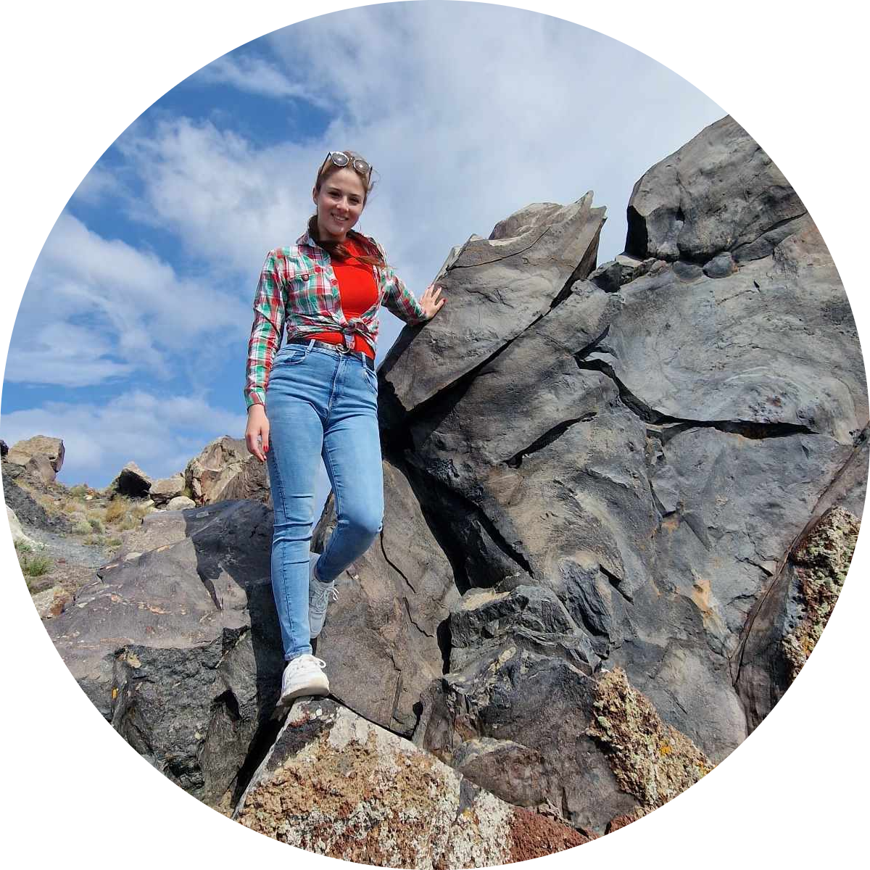

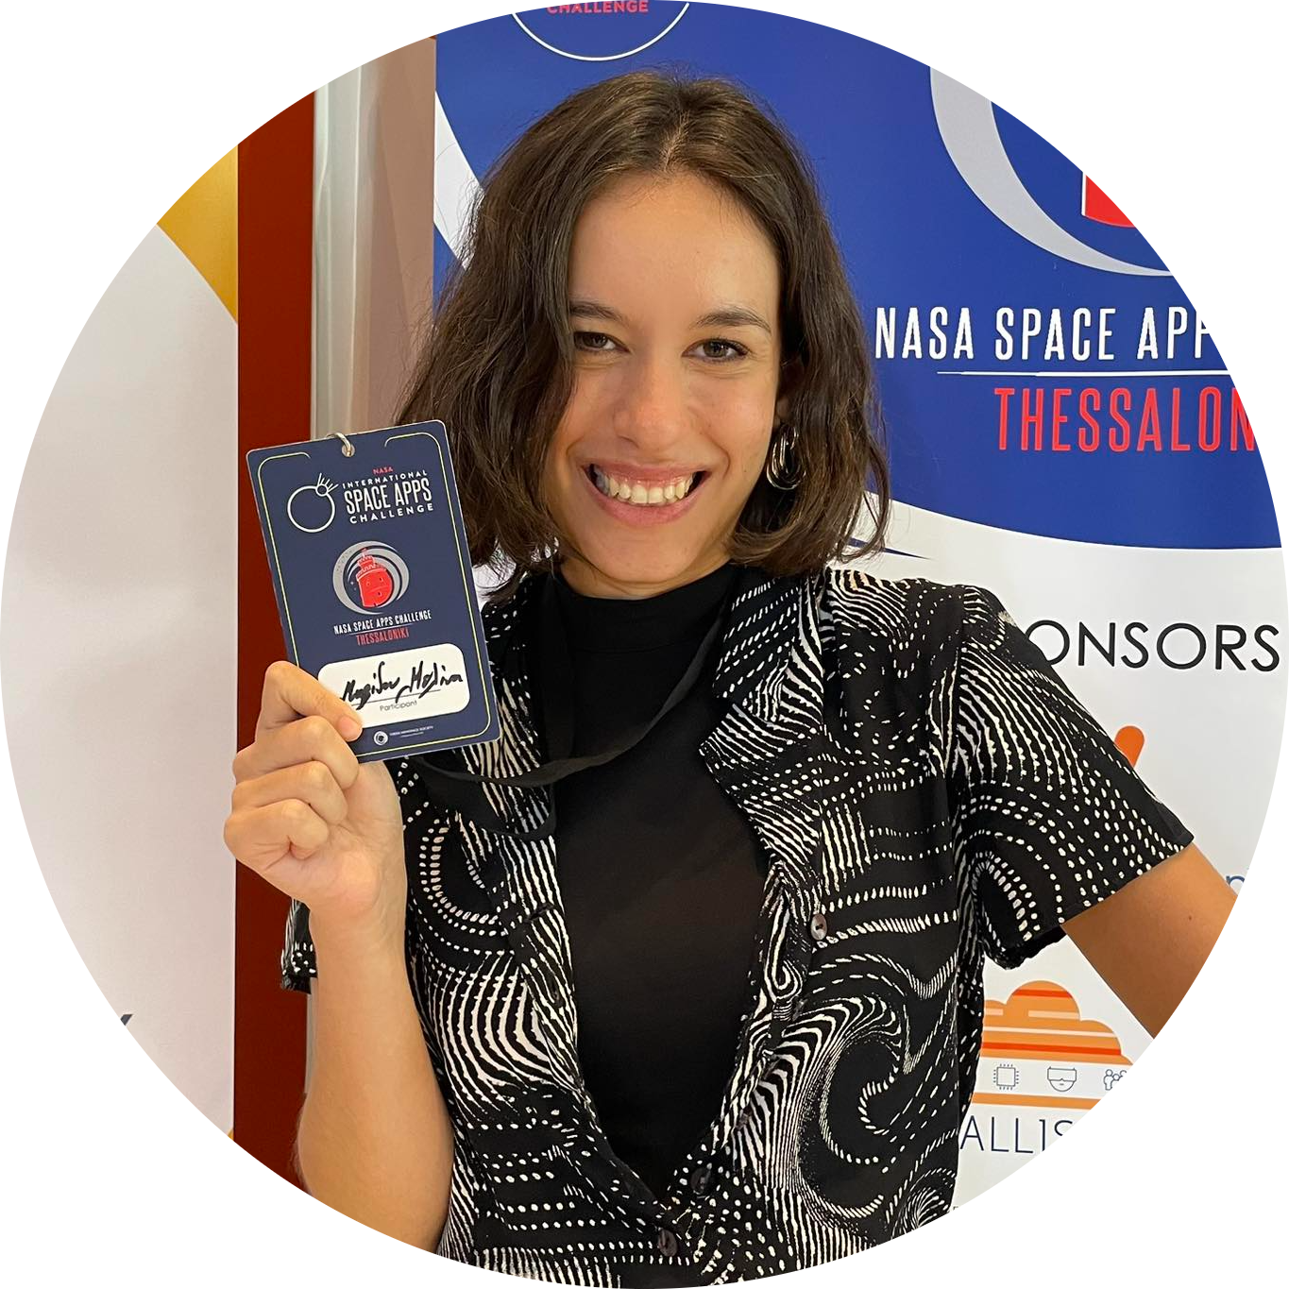


Members of our team
Aris Gkioni
Katerina Selimollari
Alexandros Mylonas
Melina Mavidou
Giorgos Vellios
Vasilis Sakellaridis

Slide 4
Our work
Provide a scientific simulation platform
VR experience
Education and entertainment
Yield a best-fit environment for conducting scientific interplanetary research
Provide a gamified VR experience through simulating conditions on habitable exoplanets
Utilize such simulations for entertainment, simulation research, innovative educational tools

Slide 5
Method of implementation
Implementation of exoplanet parameters , according to NASA data (R,T,Spectrum etc.)
Create an engaging experience through interactive storytelling
Data
Result
Step 1
Step 2
Step 3
Simulation
Utilize simulation software (Unity) to yield a visual representation of the exoplanet

Slide 6

$$N=R_{p}∗f_{p}∗n_{e}∗f_{l}∗f_{i}∗f_{c}∗L$$
The famous equation of Drake

Slide 7
Characteristics of potential planet-candidate
The requirement of sustainable life on a planetary system imposes the following restrictions on their environmental features , as listed below:
Requirements
Occurrence in the solar system
Energy | Common
Predominately light | Photosynthesis at 100AU light levels
Chemical energy | e.g. H2+CO2+CH4+H2O
Carbon | Common as CO2 and CH4
Liquid water | Rare, only on Earth for certain
N,P,S,Na and other elements | Likely to be common

Slide 8
Impact of our project
Educational
Scientific
Cultural
A simulation based on weighted parameters could yield the best-fit model exoplanet, serving as a basis that hastens the search of a possible candidate (clarity)
Given that habitable planets may foster alien life, it is natural to attempt any form of contact with benevolent intent. In that case , it constitutes a paramount event of mankind’s future (evolution)
The simulation offers a first-hand experience regarding the resemblance of a habitable exoplanet , in agreement with NASA’s provided data (insight)

Slide 9
Storytelling
You’ve just landed on the surface of an exoplanet . Out of curiosity, you begin to explore your surrounding terrain. Here’s what that looks like

Slide 10
Storytelling
Now here’s what a being living there, Billy, observes instead:

Slide 11
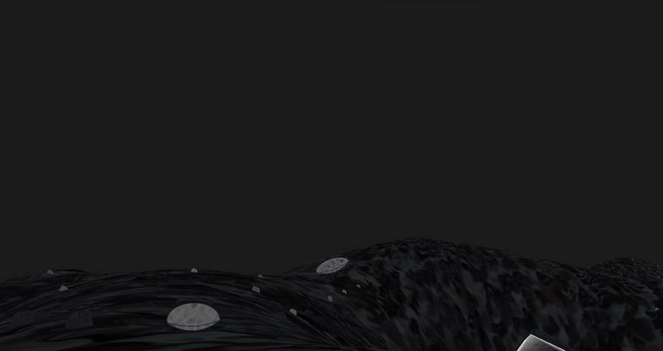
Here it is…

Slide 12
Conclusions
The simulation of extraterrestrial planetary conditions provides invaluable insight on how life might manage to adapt and flourish outside of Earth.
It facilitates perfect environments for people in any field of expertise to grasp the possibility of mankind’s perpetual expansion beyond the limits our solar system as well as test for specific feature that are prerequisites for life itself.

Slide 13

—ExoWorlds team
“In the light of the advancements to space exploration, we remain optimistic and hopeful that our project may be further expanded upon in regards to both simulating precision and raising awareness about exoplanet habitability
”

Slide 14

Thank you!

